Slide 1
Introduction to Metadata for Data Curation
(many thanks for Dr. Jerry McDonough for allowing us use of his slides for some of this talk)

Slide 2
Agenda
Basic concepts & metadata classes
Metadata for data curation
Standards to consider
The DataCite metadata kernel
Application

Slide 3
Agenda
Basic concepts & metadata classes
Metadata for data curation
Standards to consider
The DataCite metadata kernel
Application

Slide 4
What is Metadata?
“data about data”
Information that describes some aspect of an object or dataset
Should help users find, assess, and use resources
Should help data curators manage, organize and present data

Slide 5
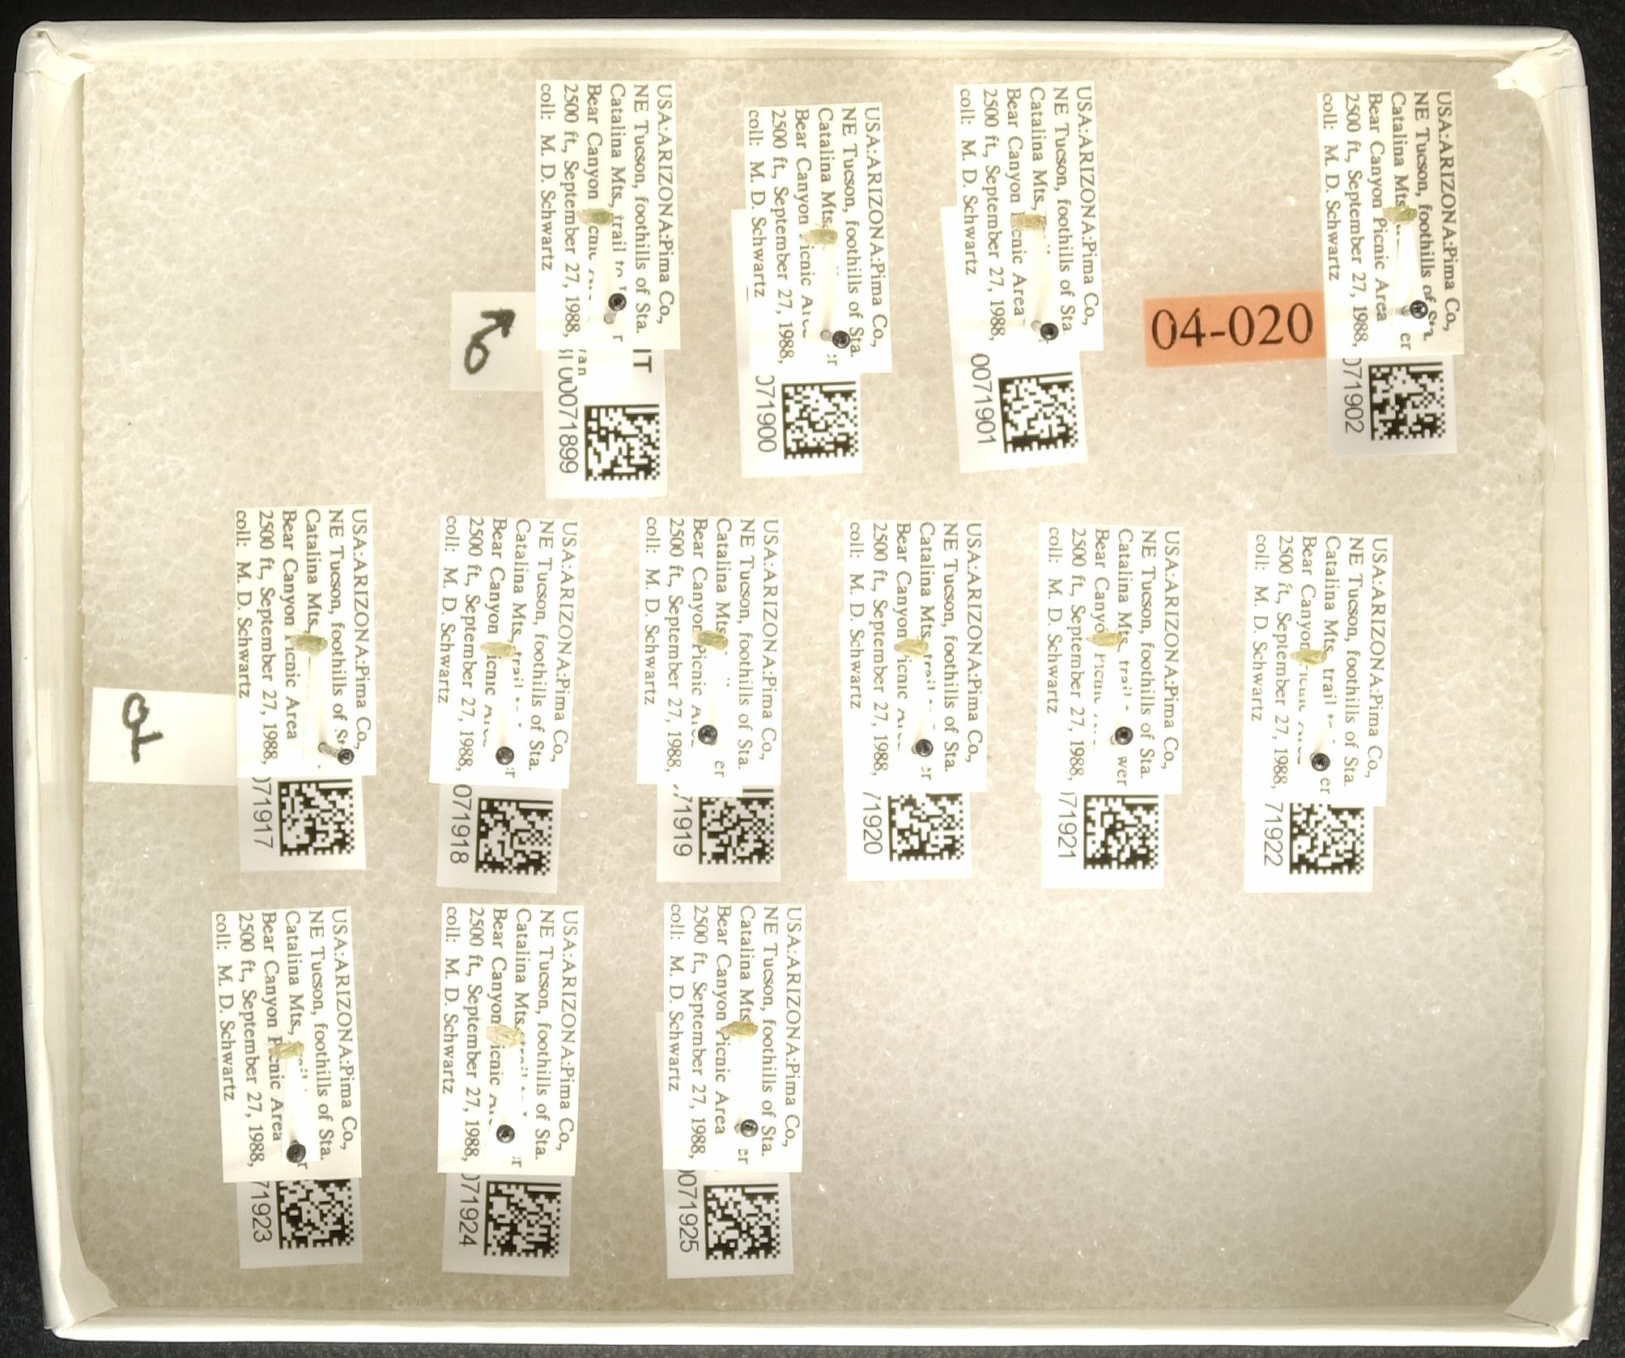
What does metadata look like?
Like data, it is a relational concept. It can look like anything…

Slide 6
What should metadata look like?
For digital data, we want machine readable expressions of our metadata… and that means
XML
Tree structure that structures attribute and value pairs
For preservation, we want stable file formats
Plain text, open format

Slide 7
Proprietary, formats like Excel are not ideal for machine readability or preservation

Slide 8
Formats like JSON and XML are easier for machines to parse

Slide 9

The important thing to remember:
Different formats can be used to encode the same data and metadata
(in this case, a collection of Hawk Moths)

Slide 10
Metadata Classes
Descriptive
Structural
Administrative
Technical
Rights & Permissions
Preservation/Provenance

Slide 11
Metadata Classes
Descriptive
Structural
Administrative
Technical
Rights & Permissions
Preservation/Provenance
Note: these are roles, not forms. The same piece of metadata can be descriptive and administrative, or structural and technical, depending on who’s reading it and why
For example:
Date=1963 is descriptive metadata if you want data from that era, but administrative if you want to know when it enters the public domain.

Slide 12
Descriptive Metadata
… describes a resource for purposes such as discovery and identification. It can include elements such as title, format, author (s), keywords, spatial coverage, date, etc.

Slide 13
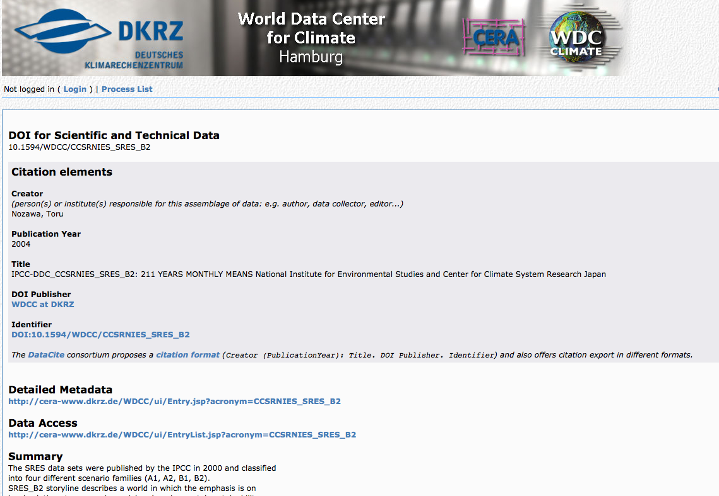
Example
http://cera-www.dkrz.de/WDCC/ui/Compact.jsp?acronym=CCSRNIES_SRES_B2

Slide 14
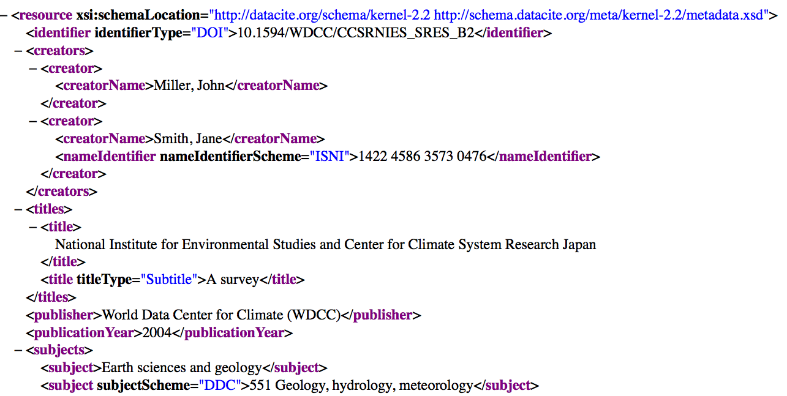

Slide 15
Structural Metadata
…indicates how compound objects are put together, for example, how pages are ordered to form chapters, or, how different observation events were combined for a “set” of data observations, etc.

Slide 16
Structural Metadata
…indicates how compound objects are put together, for example, how pages are ordered to form chapters, or, how different observation events were combined for a “set” of data observations, etc.
Dr Downie will discuss this further in the next lecture

Slide 17
Administrative Metadata
…provides information to help manage a resource, such as when and how it was created, file type and other technical information, and who can access it.

Slide 18
Subsets of Admin. Metadata
Rights management metadata, which deals with intellectual property rights (note: often embedded in preservation metadata)
Preservation metadata, which contains information needed to archive and preserve a resource.
Provenance metadata, which contains information about where the data came from and how it was created

Slide 19
Metadata Domains
Per Jane Greenberg’s MODAL Framework, metadata may have an
Environmental Domain (community that the scheme serves)
Object Class Domain (a class of object [e.g., social science data] to which it applies)
Object Format Domain (a set of objects, determined by composition [e.g., multimedia data] to which it applies)
Notes:
Jane Greenberg proposed the MODAL (Metadata Objectives and principals, Domains, and Architectural Layout) in 1995.
Her notion of objectives, the aims and goals a scheme is meant to help you fulfill, we’ve discussed under metadata functions. (principles are the rules established for meeting the objective).
Equally critical to the selection of a metadata schema, however is the notion of Domain: what is the realm in which the schema is designed to operate? Is it specific to a discipline or community? To a particular type of objects? To objects of a particular format (e.g., TEI does text, SMPTE RP210 metadata is specific to SMPTE-compliant audio/visual works).

Slide 20
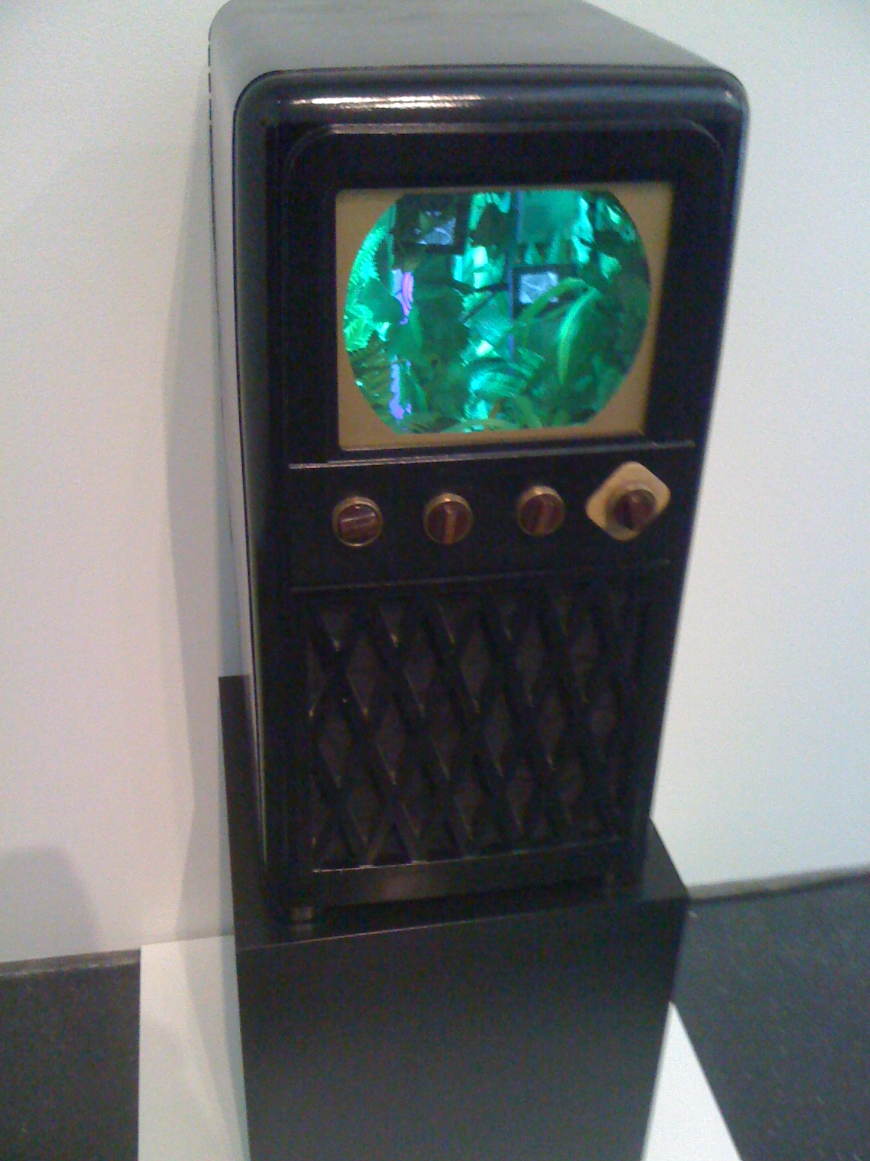
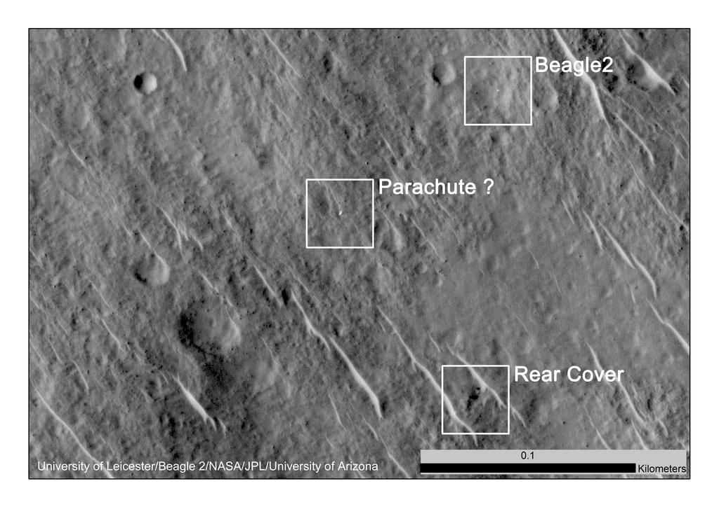
Metadata Domains
Any given schema might be applicable in:
Multiple Environmental Domains
Multiple Object Class Domains
Multiple Object Format Domains
Notes:
Multiple Environmental Domains. Example: technical metadata characterizing an audio/video stream will be just as useful in the social sciences as the physical sciences. It is not specific to an environmental domain.
Multiple object class domains: Ditto. Video feeds from the Mars Reconnaissance Orbiter are a different class of object than videos in Nam June Paik’s art work, but the same technical metadata schema could be applied to both. For that matter, the same descriptive could be applied to both (e.g., Dublin Core), although that might not be the best choice for either.
Multiple object format domains: Descriptive schema generally are not format specific. Dublin Core, MODS, MARC, all describe resources in a variety of formats. NB: some descriptive schema *are* format specific to a greater or lesser degree; VRACore is not going to be anyone’s first choice for describing digital audio recordings.
Photo of Nam June Paik work, Copyright 2014 Jerome McDonough
Photo from Mars Reconnaissance Orbiter: Image courtesy NASA/JPL-Caltech

Slide 21
Agenda
Basic concepts & metadata classes
Metadata for data curation
Standards to consider
The DataCite metadata kernel
Application

Slide 22
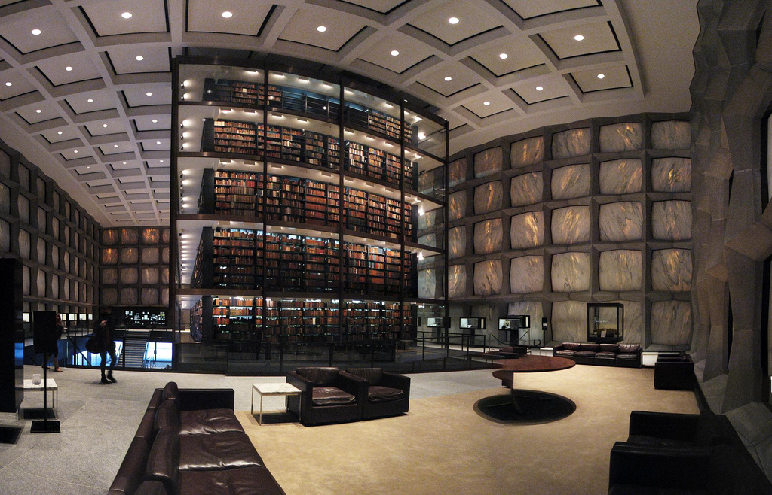
Notes:
Librarians, with their centuries of experience in creating and refining standards of bibliographic description, are accustomed a metadata world which is as regular, tidy and ordered as the best libraries. The proper standards to use for description of material are self-evident, their relationships to each other well-defined, and training and support for their use is common and widespread.
The world of data curation, being both more modern and less developed, can feel a good deal less orderly.
Image Copyright 2010 Lauren Manning, made available under Creative Commons attribution license https://creativecommons.org/licenses/by/2.0/

Slide 23
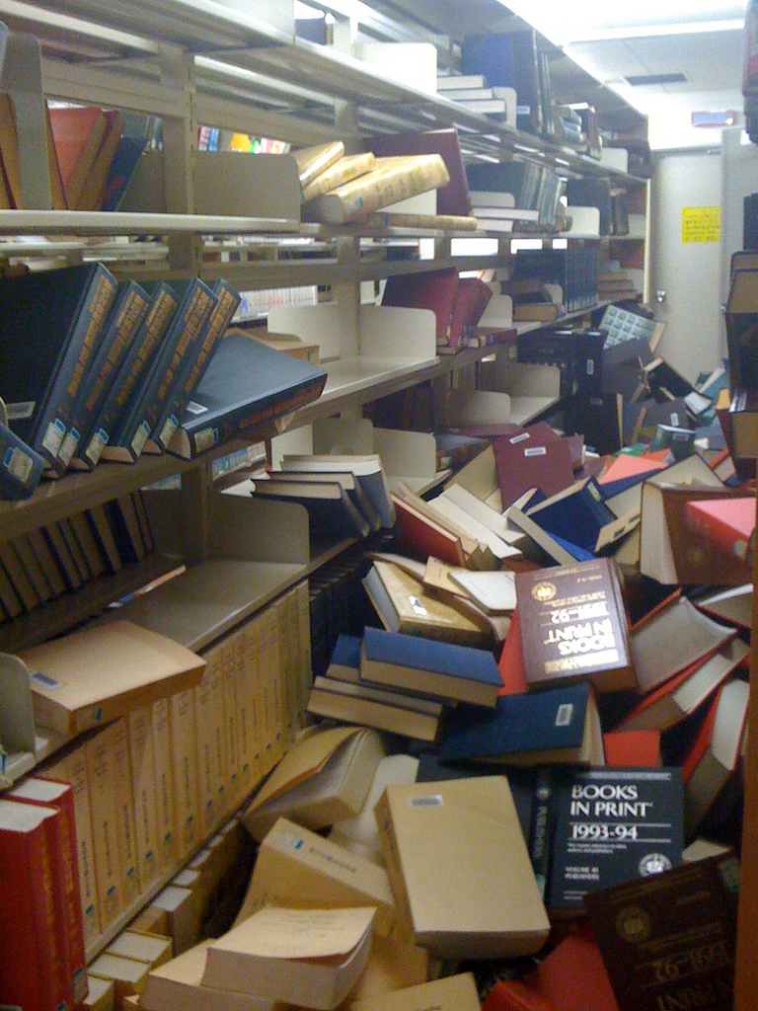
Notes:
In fact, for a librarian used to AACR2 and MARC21, the metadata practices of the data curation world can feel completely chaotic. There are far more standards to choose from, and their application is far less consistent than librarians are used to. Finding the best standards to apply to the management of data from the chaotic jumble which exists on the web and determining how to apply them can seem a thankless job.
Image Copyright 2011 Takanori Hayashi, made available under Creative Commons Attribution License https://creativecommons.org/licenses/by/2.0/

Slide 24
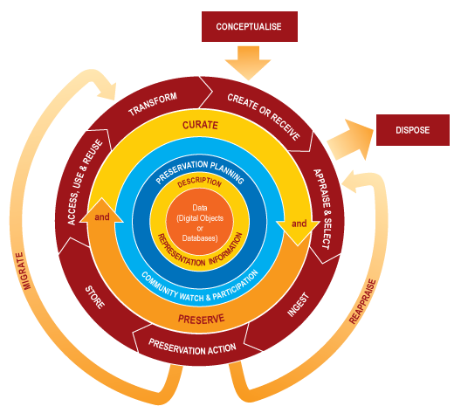
Data Curation: Metadata Functions
Notes:
The Digital Curation Centre in the UK proposed this as a model for the stages required for the successful curation and preservation of digital data. One interesting thing to note about this model: the description/representation information layer, which includes all of the “administrative, descriptive, technical, structural and preservation metadata” to insure adequate description and control over the data, is the layer which intermediates between ALL curation and and preservation actions and the data itself. Metadata provides a foundational layer upon which all curation activity depends. Let’s take a look at what those overarching functions are, and then we can talk about how the various forms of metadata work to support those functions.

Slide 25
Data Curation: Metadata Functions
Full Lifecycle Actions
Preservation Planning: plan for management & administration of all lifecycle actions
Community Watch & Participation: monitor community activities and participate in development of standards/tools/software
Curate & Preserve: undertake management & administration of data throughout its lifecycle
Notes:
Actions that are undertaken continuously throughout the curation of date include: preservation planning (determining how you will curate and preserve items in the future), community watch & participation (keeping watch on the needs of your community and the resources they have available, and working with the community to develop new resources), and curating & preserving data within your care

Slide 26
Data Curation: Metadata Functions
Full Lifecycle Actions
Preservation Planning:
Description Metadata: what do I have?
Administrative Metadata: what legal control do I have?
Technical Metadata: what do I need to use it?
Structural Metadata: where can I find all of it?
Preservation Metadata: how can I vouch for it to users?
Community Watch & Participation:
Curate & Preserve:
Notes:
Each of these functions are enable by metadata. Preservation planning requires a detailed knowledge of what’s in your repository, how you can enable access to that material (both intellectually and physically), and how you can vouch or its authenticity and reliability.

Slide 27
Data Curation: Metadata Functions
Full Lifecycle Actions
Preservation Planning:
Community Watch & Participation:
Description Metadata: what do I have, and how does that align with what the community wants?
Administrative Metadata: what legal control do I have, and does that support the community’s current needs?
Technical Metadata: what do I need to use it, and can I support my community’s use requirements? Are new standards/tools/software desirable?
Structural Metadata: where can I find all of it and is its arrangement suitable for community needs?
Preservation Metadata: how can I vouch for it to users? Can I do so to my community’s satisfaction?
Notes:
Metadata also provides a basis for guiding your interactions with the community you support.

Slide 28
Data Curation: Metadata Functions
Full Lifecycle Actions
Preservation Planning:
Community Watch & Participation:
Curate & Preserve:
Description Metadata: Establish identity, enable access and annotation
Administrative Metadata: Establish rights & permissions for curation/preservation activities and use/re-use
Technical Metadata: Establish integrity, enable necessary preservation activities, e.g., reformatting, migration
Structural Metadata: Support all other activities
Preservation Metadata: Enable continued ability to vouch for authenticity of data
Notes:
…as well as enabling the basic curation and preservation activities of an archive

Slide 29
Data Curation: Metadata Functions
Sequential Actions
Create & Receive
Appraise & Select
Ingest
Preservation Action
Store
Access, Use & Reuse
Transform
Notes:
Actions that form only part of data’s lifecycle include:
Create & Receive:
Create Data (and administrative, descriptive, structural, technical and presevation metadata as needed)
Receive Data (in accordance with policies and assign additional metadata as necessary)
Appraise & Select: evaluate data and select for long-term curation and preservation, adhering to guidelines, policies and/or legal requirements
Ingest: Transfer data to archival storage
Preservation Action: undertake actions to insure data remains authentic, reliable and usable. Maintaining authenticity requires that authenticity and integrity of data are maintained.
Store: Store the data in a secure manner adhering to relevant standards
Access, Use & Reuse: ensure that data is available to designated users and reusers, with appropriate access controls and authentication procedures in place
Transform: create new data from existing data for either preservation purposes (e.g., migration to new format) or access purposes (create a subset or derivation of data to disseminate to users)

Slide 30
Data Curation: Metadata Functions
Create & Receive: document who created data, how, and why, who may use it (and how), and how the components are related to each other
Appraise & Select: what is this material? Does it meet my standards? Can I preserve it? Must I preserve it?
Ingest: How do the pieces of data and metadata relate to each other? What are their storage requirements?
Preservation Action: Can I validate the authenticity of this? Can I decode it? Can I migrate/reformat it? And still vouch for authenticity?
Store: Can I find it all again? Can I be assured of its safety?
Access, Use & Reuse: Can users find it? Can they obtain it? Can they use it?
Transform: Can I/users successfully move the data to new formats? Can we process it to produce new subsets/derivatives?
Notes:
each of those actions involves creation of/use of descriptive, administrative, technical structural and preservation metadata
Create & Receive:
document who created data, how, and why (descriptive, technical, preservation metadata)
who may use it (and how) (administrative, technical metadata)
and how the components are related to each other (descriptive, structural, preservation metadata)
Appraise & Select:
What is this material (descriptive, technical metadata)
Does it meet my standards (descriptive, technical, administrative, preservation)
Can I preserve it? Must I? (technical, administrative)
Ingest:
How do the data/metadata relate to each other (structural)
What are their storage requirements (technical)
Preservation Action
Can I validate the authenticity of this (requires identity/integrity check, which means descriptive/technical metadata)
Can I decode it? Migrate/reformat it? (technical metadata)
And stil vouch for authenticity? (preservation metadata)
Store
Can I find it all again (Descriptive, structural)
Can I be assured of its safety (technical, administrative)
Access, Use & Reuse:
Can they find it? (descriptive, structural)
Can they obtain it (Administrative, structural)
Can they use it? (technical, structural)
Transform
Can data be successfully moved to new formats? Processed to produce new subsets/derivatives (structural, technical, administrative (yes admin, some data you need rights to change format))

Slide 31
Who creates What metadata, and When…
Curators : When data are received / ingested, preservation actions are taken, after reuse occurs.
Type: Descriptive, Structural, and (esp) Admin
Data creators: When data are collected, transformed, reused.
Type: Descriptive + Structural
Notes:
What your metadata should describe, and when are subject of next module.

Slide 32
Agenda
Basic concepts & metadata classes
Metadata for data curation
Standards to consider
The DataCite metadata kernel
Application

Slide 33
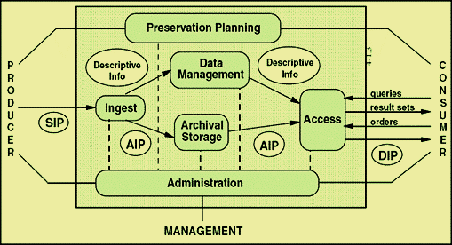
Producer vs. Manager vs. Consumer needs
Notes:
This can seem like a lot – so let’s reframe this according to one of the lifecycle models we looked at yesterday
Another way to divide types of metadata is by the groups of users it aims to serve

Slide 34
Manager (e.g. your) Needs
Before looking at schemas, articulate the “specificities” of your repository
What are your institution’s needs? What are the practical constraints of your work?

Slide 35
“Nine questions” for needs assessment
From Kennedy, 2008:
Who will be using the collection?
Who is the collection cataloguer?
How much time/money do you have?
How will your collection be accessed?
Notes:
Before we start looking at and comparing schemas its important to ask, “what’s the goal”
She’s not talking about data –
Still an emerging set of resources about data objects

Slide 36
Kennedy 2008 continued
How is your collection related to other collections?
What is the scope of your collection?
Will your metadata be harvested?
Do you want your collection to work with other collections?
How much maintenance or quality control do you wish?

Slide 37
Consumer needs
How is your collection related to other collections?
What is the scope of your collection?
Will your metadata be harvested?
Do you want your collection to work with other collections?
How much maintenance or quality control do you wish?
Notes:
These questions point to the need to also evaluate consumer needs:

Slide 38
Standards to Consider
Descriptive Metadata
Environmental Domain Agnostic
Dublin Core
MODS
Environmental Domain Specific
Darwin Core
DDI
EML

Slide 39
Standards to Consider
Dublin Core
Most widely used metadata schema (e.g., see DSpace, OAI-PMH)
Simplest of schema to use/implement
Generally applicable to any web resource
But, extremely generic element set designed to describe anything. May require application profiles that invoke other schema (e.g., DarwinCore)

Slide 40
Standards to Consider
MODS
Schema for describing digital bibliographic objects
Maintained by Library of Congress
Allows for deeply nested hierarchical descriptions where full MODS vocabulary is available at each level of hierarchy
Does reflect a library-centric viewpoint, i.e., it’s really designed for describing published materials

Slide 41
Standards to Consider
Darwin Core
Maintained by TDWG organization
An application profile of Dublin Core w/ extensive additional elements for biodiversity information, primarily based on taxa.
Includes a set of curatorial terms (e.g., Catalog #, Collector #, Field #, Related Cataloged Items, etc.)
Used by many museums, Global Biodiversity Information Facility (GBIF)

Slide 42
Standards to Consider
Data Documentation Initiative (DDI)
Schema for describing social science data sets and related materials, maintained by DDI Alliance
Extensive XML Schema that cover data concepts, collection methods, processing, distribution & analysis, along with descriptive metadata on data sets and related publicatsion and preservation metadata
Includes facilities for characterizing structure of data sets to automate their processing in software like SAS, Stata and SPSS

Slide 43
Standards to Consider
Ecological Metadata Language (EML)
Modular XML schema for describing ecological data for data analysis and archiving
Top level modules for describing data sets, providing citations to literature, identify software to working with a data set, and describing research protocols
Specialized authoring/editing software (Morpho) available
Used by Global Biodiversity Information Facility (GBIF) and the Long Term Ecological Research (LTER) Network

Slide 44
Standards to Consider
Structure
OAI-ORE
METS
XFDU (CCSDS 661.0-B-1)
Notes:
Some metadata standards such as EML and DDI provide fairly extensive facilities for linking resources on their own. However, if you feel need to supplement those, there are some structural metadata standards you might investigate, including
OAI-ORE: Open Archives Initiative Object Reuse and Exchange. RDF-based. VERY web-centric in viewpoint, so lends itself very well to a Linked Open Data environment, but not so well to situations where you have digital resources to which you have not assigned URIs (e.g., local file system materials, networked/hierarchical storage systems that don’t provide web access). Depending on other RDF schema/Ontologies for descriptive languages, so may not be as useful if the rest of your metadata is not in RDF/XML format.
METS: XML schema for structuring digital library objects, created by the Digital Library Federation and maintained by the METS Editorial Board and the Library of Congress. Good at binding data and metadata together, either within a single file or linking items on the web or distributed on a file system. Relies on other XML schema for other types of metadata (e.g., MODS, PREMIS, DC, MIX, etc.).
XFDU: XML Formatted Data Units, a.k.a. CCSDS 661.0-B-1 (the people who brought you OAIS Reference Model). A METS-like XML schema language for constructing Archival Information Packages within the OAIS Reference Model. Like METS, dependent on other XML schema for additional metadata.

Slide 45
Standards to Consider
Technical Metadata
Text: TextMD http://www.loc.gov/standards/textMD/
Image: Z39.87/MIX http://www.loc.gov/standards/mix/ & EXIF
Audio: AES57-2011 http://www.aes.org/publications/standards/search.cfm?docID=84
Video: VideoMD http://www.loc.gov/standards/amdvmd/
Notes:
Much of the characterization of data sets structure can be handled by codebook standards like DDI or EML, or more basic standards like DFDL. However, actually it is useful to have metadata standards for describing the technical aspects of a data file beyond it’s structure. There are several standards which have emerged from the digital library community over the past few years that can be useful for describing the technical aspects of data files, including:
TextMD: a standard maintained by Library of Congress for characterizing textual data files, including character set, byte order, line terminators, markup and font information.
Z39.87/MIX: MIX is an XML implementation of NISO’s Technical Metadata for Digital Still Images (Z39.87). It captures information on image characteristics such as color space, ICC profiles, format and byte order, as well as information about source objects, image capture tools and techniques, and quality assurance information.
AES57-2011: From the Audio Engineering Society, allows you to record information on the physical properties of recording media, signal characteristics like playback speed and noise reduction, digital file characteristics like encoding, sampling rates, bit depth and byte order, and condition information for preservation purposes
VideoMD: Another Library of Congress standard, this provides basic technical metadata about video streams, including media description, frame description (rate, size), data rate, format, chroma subsampling, etc.

Slide 46
Standards to Consider
Rights & Permissions
CopyrightMD (California Digital Library) http://www.cdlib.org/groups/rmg/
Open Digital Rights Language (ODRL) http://www.w3.org/TR/odrl/
Notes:
Rights and permissions is one of the more complicated areas for metadata schema, and one where the existing schemas have been designed to work within very particular contexts. For some people, a simple rights element, such as Dublin Core’s <dc:rights> might suffice. For people who need something more sophisticated, two possibilities to examine are:
CopyrightMD: developed by U.C.’s California Digital Library group to document the copyright status of works in detail
ODRL: an attempt to create an open-source digital rights language that records both rights and permissions information, now maintained by the World Wide Web Consortium. Fairly flexible, but does betray its original design intentions a bit: enabling sales of electronic content over the web and providing a non-proprietary language to drive digital rights management systems (i.e., something akin to the MPEG-21 rights expression language)

Slide 47
Standards to Consider
Preservation & Provenance
PREMIS – rights, life cycle and agent information regarding digital objects, in XML schema format
Open Provenance – XML Schema, OWL ontology and Java Library to provide digital representation of provenance for anything
Prov-DM – A World Wide Web Consortium project, providing a data model to describe provenance relationships between entities, activities and people, with OWL and XML serializations
Notes:
Curation involves documenting the life cycle of objects, and that will mean of necessity you have to record some information about object’s provenance over time. Several languages and models have been developed over the past decade to support this including….

Slide 48
Agenda
Basic concepts & metadata classes
Metadata for data curation
Standards to consider
The DataCite metadata kernel
Application

Slide 49
DataCite metadata schema
The DataCite Metadata schema is:
“a list of core metadata properties chosen for the accurate and consistent identification of a resource for citation and retrieval purposes, along with recommended use instructions”

Slide 50
DataCite metadata schema
The DataCite Metadata schema is:
“a list of core metadata properties chosen for the accurate and consistent identification of a resource for citation and retrieval purposes, along with recommended use instructions”
Notes:
Citation and retrieval = a core need for data, that many of these other data schemas just don’t address.

Slide 51
DataCite metadata schema
3 levels of metadata:
Mandatory (M)
Recommended (R)
Optional (O)
“Those clients who wish to enhance the prospects that their metadata will be found, cited and linked to original research are strongly encouraged to submit the Recommended as well as Mandatory set of properties”

Slide 53
Agenda
Basic concepts & metadata classes
Metadata for data curation
Standards to consider
The DataCite metadata kernel
Application

Slide 54
Metadata Application
Policies & Procedures
Remember, a schema only defines a record syntax.
Document rules for metadata creation, including formatting rules, chief sources of information for metadata elements, controlled vocabularies for use in your institution, etc.

Slide 55
Metadata Application
Application Profiles
In many cases, no one schema does everything you need, and you have to mix and match. Define and record rules for this.
METS Profiles – document…
All external schema you use and the elements from each
All rules of description you use for each schema
All controlled vocabularies you use for each schema
Limitations on elements’ use beyond those in the schema
Any tools you’ve developed to support the application profile

Slide 56
Metadata Application
Workflows
Decide and document who does what metadata when
Make sure everyone knows what they’re supposed to do and train them to do it
Revisit those decisions and documentation on at least an annual basis

Slide 57
Metadata Application
System Integration
It would be nice if all of this worked well together.
It doesn’t.
As part of your workflow documentation, document transitions of metadata between systems and how they should take place. Update when systems change.
Test metadata exchange between systems to insure nothing is added or lost.

Slide 58
Resources
About the DataCite Metadata Kernal:
https://schema.datacite.org/meta/kernel-3/doc/DataCite-MetadataKernel_v3.1.pdf
MODAL framework:
Willis, C., Greenberg, J., & White, H. (2012). Analysis and synthesis of metadata goals for scientific data. Journal of the American Society for Information Science and Technology, 63(8), 1505-1520.
Greenberg, J. (2005). Understanding metadata and metadata schemes. Cataloging & classification quarterly, 40(3-4), 17-36.
Kennedy, M. R. (2008). Nine questions to guide you in choosing a metadata schema. Journal of Digital Information, 9(1). https://journals.tdl.org/jodi/index.php/jodi/article/viewArticle/226

Slide 59
Standards to Consider
Data Characterization / Representation Information
Description
Structure
Technical
Rights
Preservation / Provenance
Notes:
As we’ve discussed, curation involves a variety of functions, all of which depend on/map to metadata elements (any one of which may actually support multiple functions). Some schema are more specific to others with respect to the fields of inquiry they support of the type of object they describe. Given that, what metadata schema might you keep an eye on in developing a metadata architecture for your institution? Within each of these six areas, there are a variety of schema which have achieved a sufficient level of development and support you might want to consider for use.

Slide 60
Standards to Consider
Data Characterization / Representation Information
Data Format Description Language
HDF5
Remember that some ‘descriptive’ schema such as DDI and EML have data characterization components
Notes:
Representation information, which allows binary data to be decoded both at the level of primitive data types and higher level semantics, is essential to data preservation. Some standards such as DDI and EML include data characterization as part of the facilities they support, but there are some schema which are specifically intended to support defining data formats in a platform-independent manner. Two notable examples you may hear of from the Big Data World
Data Format Description Langauge
HDF5
Remember: some other schema such as the Data Documentation Initiative and Ecological Metadata Language do include data characterization facilities, but they tend to be a bit more specific to an environmental domain or object class domain, and hence not as flexible for other purposes.

Slide 61
Standards to Consider
Data Format Description Language
Language for describing text & binary data formats
Based on W3C XML Schema Language
Maintained by the Open Grid Forum
Part of IBM’s Integration Bus
A public repository for DFDL schemas for common commercial and scientific data formats exists on GitHub
Open Source tools for working with DFDL available (e.g., Daffodil from NCSA)
Notes:
“Data Format Description Language (DFDL, often pronounced daff-o-dil), published as an Open Grid Forum Proposed Recommendation in January 2011, is a modeling language for describing general text and binary data in a standard way. A DFDL model or schema allows any text or binary data to be read (or "parsed") from its native format and to be presented as an instance of an information set. The same DFDL schema also allows data to be taken from an instance of an information set and written out (or "serialized") to its native format.”

Slide 62
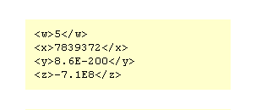
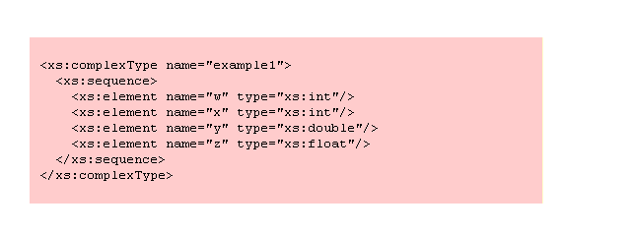
Standards to Consider
Data Format Description Language: Example
We can describe this…
…using this.
Notes:
This example looks similar to XML Schema (because it is), but DFDL can define binary data types just as easily as this markup language example.

Slide 63
Standards to Consider
HDF5 (Hierarchical Data Format)
Data format designed for large (petascale) data sets
Self Describing (like XML), supports arbitrarily large and complex data relationships and dependencies, as well as user-defined metadata
Maintained by the HDF Group
Used by NASA’s Earth Observing System and NOAA/NASA Joint Polar Satellite System
Well-developed software toolset
Notes:
NB: DFDL characterizes an existing data format and is a better choice for representation information. HDF5 is a highly flexible and scalable data format capable of handling different forms of scientific data and metadata equally well.

